Slide 1

Big Data Session 1
Dr. Nilay Karade
Academic Head

Slide 2

Know Your Mentor
Qualification
Ph D in AI
Master in Computer Application
15 Years of experience
Software Industry
Data Science consultant
Web developer
Mobile app developer
Teaching
Corporate Trainer
Associate Professor
Assistant Professor
Areas of specialization
AI & Data Science
Web and android app development
Cloud computing
MLOps
BI
Publications – Books, Research papers
Dr. Nilay Karade
www.linkedin.com/in/dr-nilay-karade
nilayk@regenesys.net

Slide 3
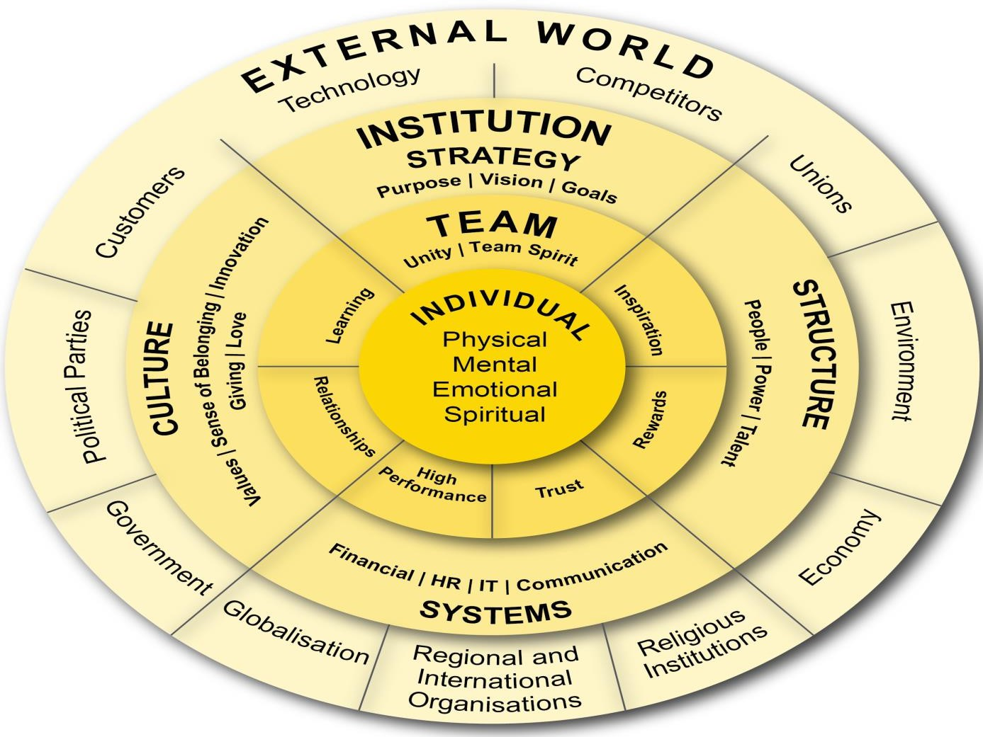
REGENESYS’ INTEGRATED LEADERSHIP AND MANAGEMENT MODEL
Holistic focus on the individual (SQ, EQ, IQ, and PQ)
Interrelationships are dynamic between individual, team, institution and the external environment (systemic)
Strategy affects individual, team, organisational, and environmental performance
Delivery requires alignment of strategy,
structure, systems and culture

Slide 4
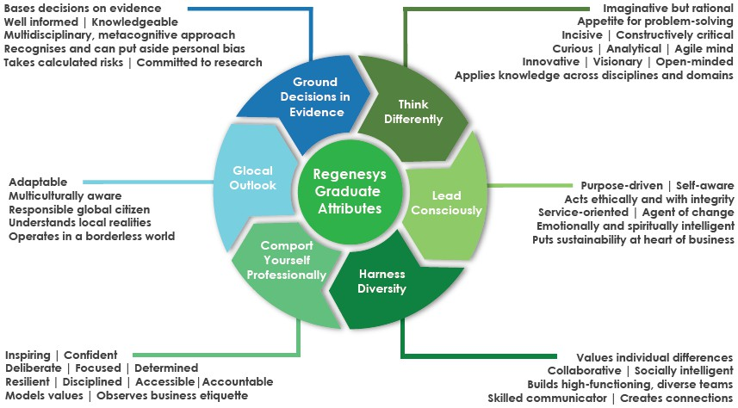
REGENESYS GRADUATE ATTRIBUTES

Slide 5
Ground Rules
Be open-minded
Listen carefully
Avoid doing other unrelated tasks when attending the session so that you can be FOCUSED.
Raise your hand if you have any query so that we can ensure one conversation at a time
When speaking, use “I think”, “I feel”, etc. (you are a very important aspect of this learning)
Respect the opinions of others
Give constructive feedback
Build on the ideas of others rather than destroying them
Take some risks and share new ideas
Have fun and ENJOY the learning experience!

Slide 6
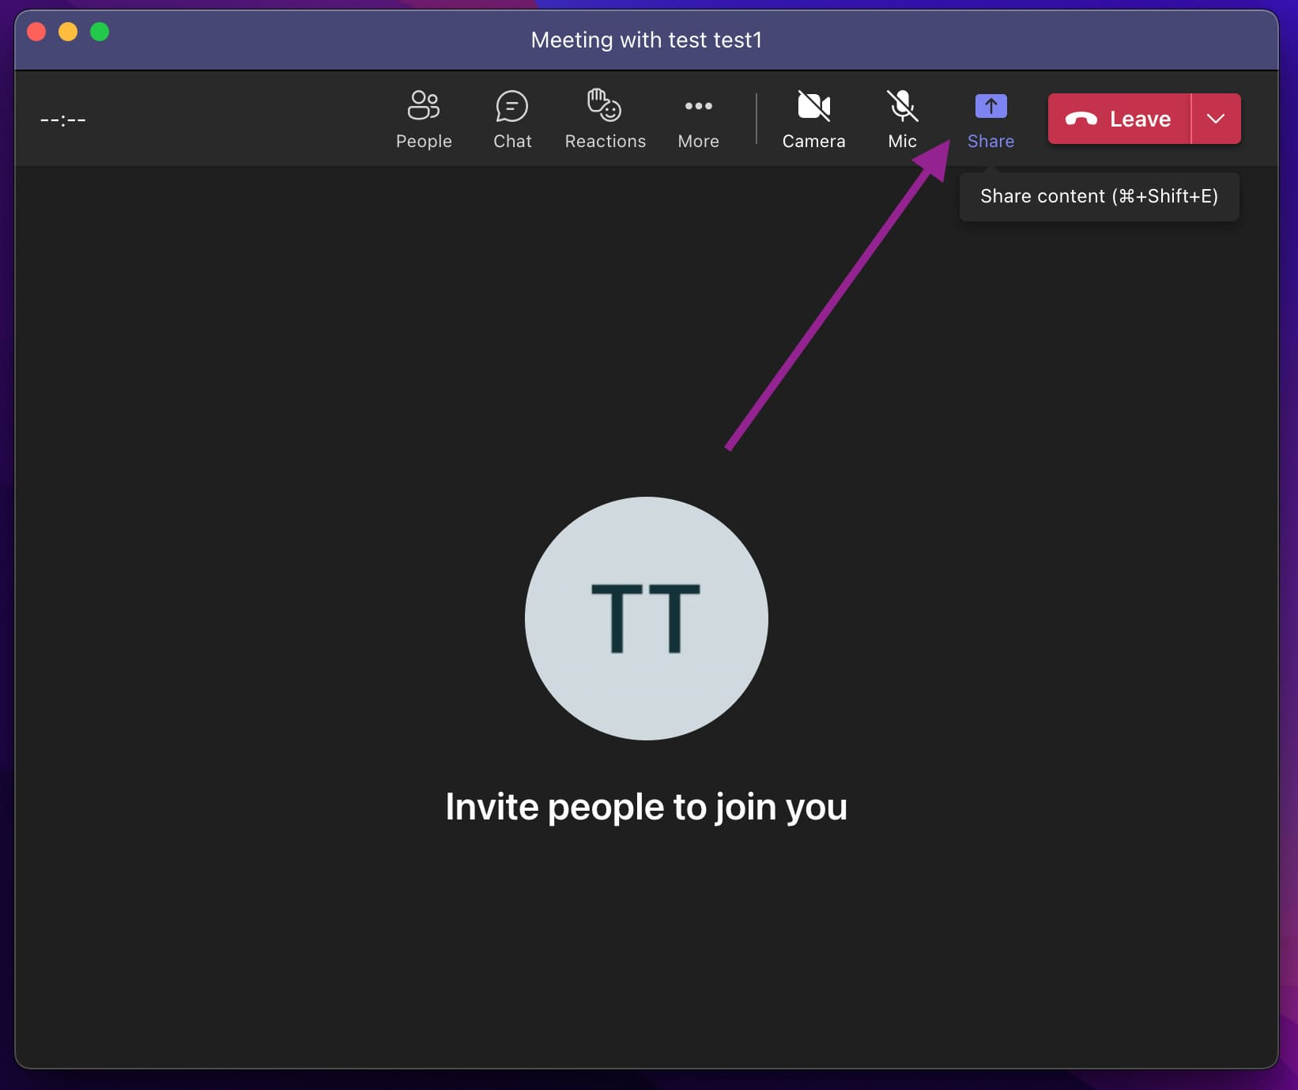
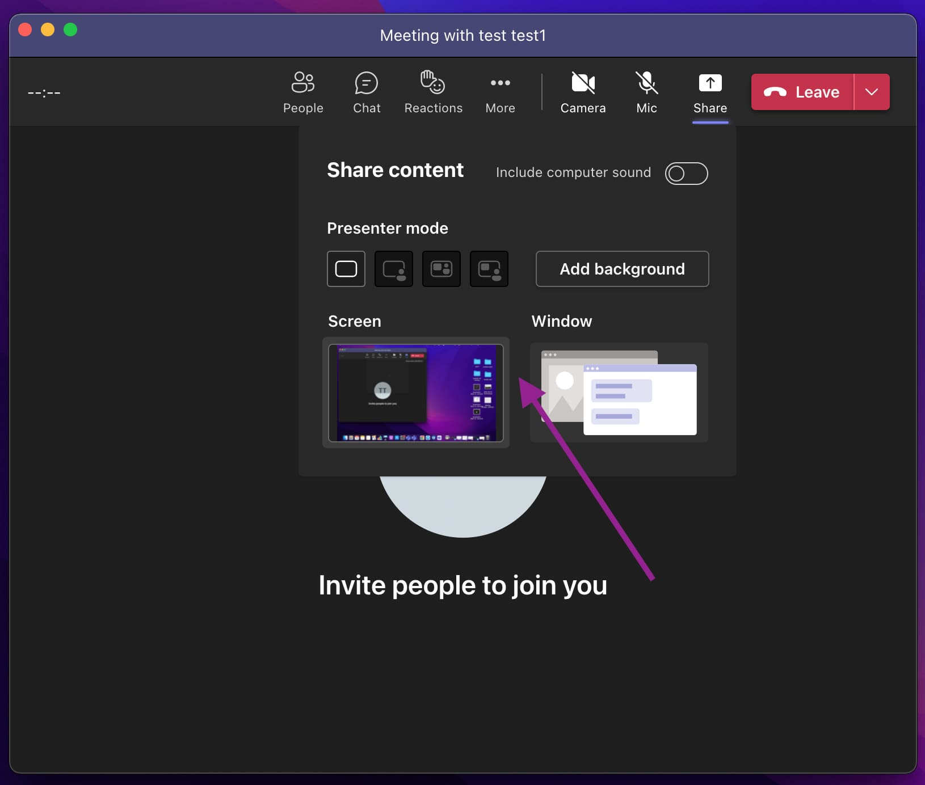
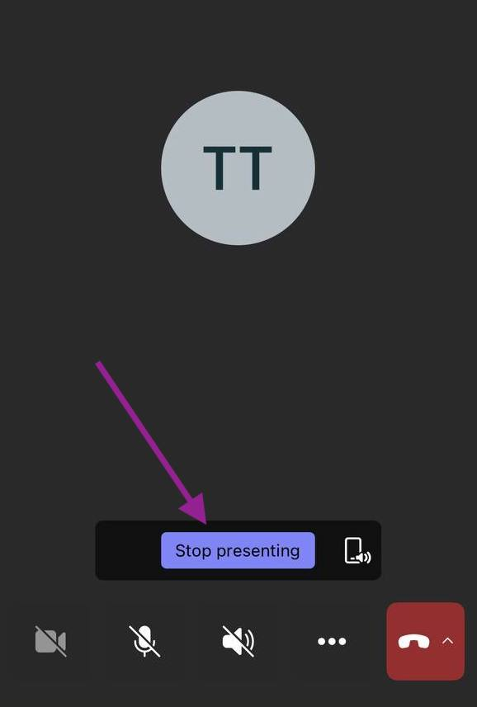
Ground rules
Source https//www.helpwire.app/blog/share-screen-on-microsoft-teams/

Slide 7
Big Data
Session 1
Introduction Big Data & Distributed Computing
PySpark DataFrame
Session 2
PySpark DataFrame
PySpark SQL
Session 3
PySpark ML
Session 4
PySpark NLP
Session 5
Streaming with Apache Kafka

Slide 8
Agenda
What is Big Data?
Examples
Challenges
Benefits
Introduction distributed system
Architecture
Benefits
Spark & PySpark
PySpark DataFrame
Basic functions
Data handling
Task Data Analysis using PySpark DataFrame
Formulation of problem statement
Code implementation

Slide 9
Data units
Bit (b):
1 bit is the smallest unit of digital information. Binary digit representing 0 or 1.
Byte (B):
1 byte consists of 8 bits. Commonly used for representing a character or small amount of data.
Kilobyte (KB):
1 kilobyte is equivalent to 1,024 bytes. Often used to measure the size of small text documents or images.
Megabyte (MB):
1 megabyte is equivalent to 1,024 kilobytes or 1,048,576 bytes. Commonly used for file sizes in documents, images, and music.
Gigabyte (GB):
1 gigabyte is equivalent to 1,024 megabytes or 1,073,741,824 bytes.
Used to measure the size of larger files, software, and videos.
Terabyte (TB):
1 terabyte is equivalent to 1,024 gigabytes or 1,099,511,627,776 bytes. Commonly used for measuring large amounts of data, such as storage capacities of hard drives.

Slide 10
Data units
Petabyte (PB):
1 petabyte is equivalent to 1,024 terabytes or 1,125,899,906,842,624 bytes.
Used in contexts such as data centers and large-scale storage systems.
Exabyte (EB):
1 exabyte is equivalent to 1,024 petabytes or 1,152,921,504,606,846,976 bytes.
Commonly used to represent extremely large datasets, such as global internet traffic.
Zettabyte (ZB):
1 zettabyte is equivalent to 1,024 exabytes or 1,180,591,620,717,411,303,424 bytes.
Used to quantify data on a global scale, including annual data creation.
Yottabyte (YB):
1 yottabyte is equivalent to 1,024 zettabytes or 1,208,925,819,614,629,174,706,176 bytes.
This unit is rarely used currently but is considered in discussions about the future of data storage and processing.

Slide 11
What is Big Data?
Big Data refers to extremely large and complex datasets that cannot be easily managed, processed, or analyzed with traditional data processing tools. The term "big" in Big Data doesn't only refer to the size of the data but also encompasses its various characteristics. There are three key dimensions, often referred to as the 3Vs
Volume Big Data involves large amounts of data, typically ranging from terabytes to petabytes and beyond. The sheer volume of data is one of the defining characteristics of Big Data.
Velocity Big Data is generated at an unprecedented speed. This includes data streaming in real-time from various sources such as social media, sensors, and other digital platforms. The velocity of data creation and processing is crucial for making timely decisions.
Variety Big Data comes in various forms, including structured, semi-structured, and unstructured data. Structured data is organized and easily queryable, like data in relational databases. Semi-structured data has some organizational properties but lacks a fixed schema, such as JSON or XML files. Unstructured data is data that doesn't have a predefined data model or is not organized in a predefined manner, like text documents, images, videos, and social media content.

Slide 12
Examples of Big Data
Google Searches
Over 5.6 billion Google searches are conducted per day, translating to more than 63,000 searches every second.
Facebook Data
Facebook users upload around 350 million photos per day.
Every minute, approximately 300,000 status updates are posted on Facebook.
YouTube
Over 500 hours of video content are uploaded to YouTube every minute.
Twitter
Twitter users send out approximately 500 million tweets per day.
E-commerce Transactions
During peak times, major e-commerce platforms can process thousands of transactions per second.

Slide 13
Examples of Big Data
Internet of Things (IoT)
By 2030, it's estimated that there will be around 125 billion connected IoT devices globally, contributing significantly to the volume of data generated.
Financial Transactions
The New York Stock Exchange (NYSE) alone handles billions of transactions on a daily basis.
Healthcare Data
The global healthcare data is expected to reach 2314 exabytes by 2020, driven by the adoption of electronic health records and medical imaging.
Scientific Research
Large Hadron Collider (LHC) at CERN generates approximately 30 petabytes of data annually from particle collision experiments.

Slide 14
Mobile Data traffic reached 370 exabytes per month globally in 2022.
Location Data
App Usage Data
Communication Data
Browsing Data
Device and System Data
Sensor Data
Biometric Data
Social Media Interactions
Payment and Transaction Data
Health and Fitness Data
Media Capture Data

Slide 15
Mobile Data traffic reached 370 exabytes per month globally in 2022.
Location Data
GPS and location-based services provide real-time information about the user's geographic location. This data is utilized in mapping apps, location-based recommendations, and geotagging features.
App Usage Data
Information about the apps users interact with, the time spent on each app, and the frequency of use. App developers use this data to enhance user experience and optimize app performance.
Communication Data
Data related to calls, text messages, and multimedia messages. This includes call logs, message content, and details about contacts.
Browsing Data
Information about websites visited, search queries, and online interactions. This data is used for personalized content recommendations, targeted advertising, and improving browsing experiences.
Device and System Data
Technical details about the mobile device, including the operating system, device model, hardware specifications, and software versions. This data helps developers ensure compatibility and optimize their apps.
Sensor Data
Many mobile devices are equipped with various sensors, such as accelerometers, gyroscopes, and ambient light sensors. Sensor data is utilized in fitness apps, augmented reality applications, and other sensor-dependent functionalities.

Slide 16
Mobile Data traffic reached 370 exabytes per month globally in 2022.
Biometric Data
With the introduction of biometric authentication methods like fingerprint scanning and facial recognition, mobile devices generate and store biometric data for security purposes.
Social Media Interactions
Data related to social media activities, including posts, likes, shares, and comments. Social media platforms leverage this information for content personalization and targeted advertising.
Payment and Transaction Data
Mobile users generate data through transactions made using mobile payment systems and digital wallets. This includes purchase history, payment methods, and transaction details.
Health and Fitness Data
With the proliferation of health and fitness apps, mobile users generate data related to their physical activity, sleep patterns, and other health metrics.
Media Capture Data
Photos, videos, and audio recordings captured by mobile users contribute to a significant amount of data. This media data is often stored locally or uploaded to cloud services.

Slide 17
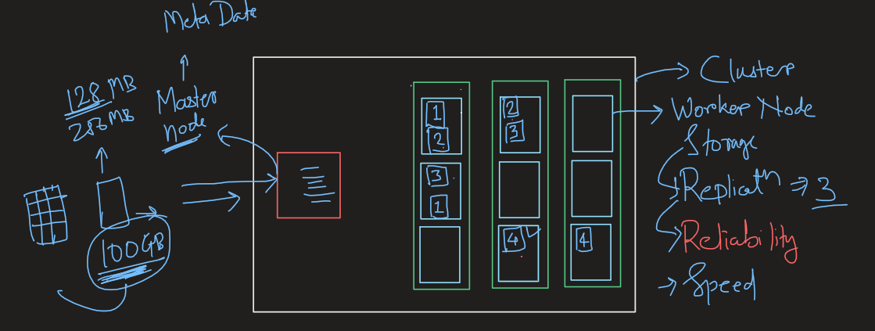
Distributed computing system

Slide 18
Spark
Apache Spark is an open-source distributed computing system that provides a fast and general-purpose cluster-computing framework for big data processing.
Developed by the Apache Software Foundation, Apache Spark is designed to be fast, flexible, and easy to use. It enables distributed data processing for large-scale datasets across clusters of computers.

Slide 19
Spark Features
Speed (HDD vs RAM storage):
Apache Spark is known for its speed and efficiency, outperforming traditional big data processing frameworks like Hadoop MapReduce. It achieves this through in-memory data processing, reducing the need to write intermediate results to disk.
Ease of Use:
Spark provides high-level APIs in Java, Scala, Python, and R, making it accessible to a wide range of developers with different programming language preferences. It also comes with built-in libraries for diverse tasks, simplifying the development process.
Versatility:
Spark supports a variety of workloads, including batch processing, iterative algorithms, interactive queries (SQL), and streaming. This versatility allows users to use a single framework for multiple data processing tasks.
Fault Tolerance:
Spark offers fault tolerance through the concept of Resilient Distributed Datasets (RDDs). RDDs are immutable distributed collections of objects, and they automatically recover from node failures.
Distributed Computing:
Spark distributes data processing tasks across a cluster of machines, promoting scalability. It leverages a master/worker architecture where a central coordinator (master) manages distributed computation across multiple worker nodes.

Slide 20
Spark
Spark Core:
The foundational component of Apache Spark is Spark Core, which provides the basic functionality for distributed task scheduling, fault recovery, and data distribution. It includes the Resilient Distributed Dataset (RDD) abstraction.
Spark SQL:
Spark SQL allows users to query structured data using SQL syntax. It provides a DataFrame API for manipulating data in a structured format, similar to a table in a relational database.
Spark Streaming:
Spark Streaming enables the processing of real-time streaming data. It allows users to apply batch processing techniques to streaming data sources, making it suitable for real-time analytics.
MLlib (Machine Learning Library):
MLlib is a scalable machine learning library included in Spark. It provides a wide range of machine learning algorithms and tools for building and evaluating machine learning models at scale.

Slide 21
PySpark
PySpark is an open-source Python library and one of the core components of the Apache Spark ecosystem.
It enables Python developers to work with Apache Spark, a distributed, high-performance computing framework designed for big data processing.
PySpark combines the power of Spark's distributed computing capabilities with the simplicity and versatility of the Python programming language.

Slide 22
Summary
What is Big Data?
Examples
Challenges
Benefits
Introduction distributed system
Architecture
Benefits
Spark & PySpark
PySpark DataFrame
Basic functions
Data handling

